Slide 1
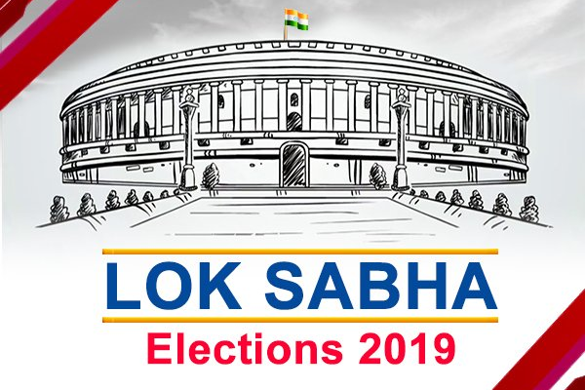
Indian Election - 2019

Slide 2

Agenda
Introduction
Project Objective
Analysis
Observation
suggestions

Slide 3
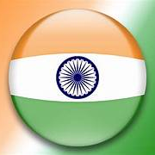
Introduction
The ANALYSIS HERE IS BASED ON THE ELECTION OF LOK SABHA – 2019 ,MEMBERS OF LOK SABHA ARE ELECTED BY BEING VOTED UPON BY ALL ADULT CITIZENS OF INDIA, FROM A SET OF CANDIDATES WHO STAND IN THEIR RESPECTIVE CONSTITUENCIES.
CANDIDATES WHO WIN THE LOK SABHA ELECTIONS ARE CALLED ‘MEMBER OF PARLIMENT’ AND HOLD THEIR SEATS FOR 5 YEARS OR UNTIL THE BODY IS DISSOLVED BY PRESIDENT ON THE ADVICE OF THE COUNCIL OF MINISTERS.

Slide 4

PROJECT OBJECTIVE
To identify the party that won the Lok Sabha 2019 election.
To conduct a comparative analysis of party performance in election.
To analyze the performance of different parties across different states
To analyze the key trends in voter turnout and vote share
To analyze most important factors that influence a candidate's chance of winning
To analyze the relationship between a candidate's personal wealth and their political success

Slide 5

What is the number of candidates who contested the election?
Observation:
2263 candidates contested the election.

Slide 6
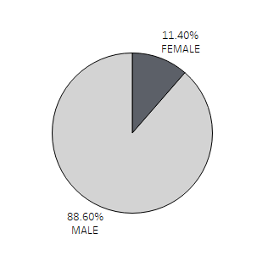
What is the percentage of male & female candidates who were elected in election?
Observation:
89.60% of male candidates won election and 11.40% of female candidates won election

Slide 7
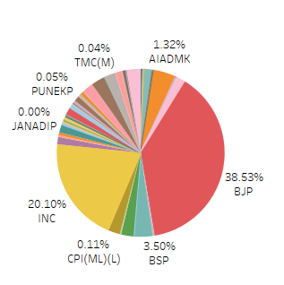
What is the vote share of party?
Observation:
BJP has 38.53% of votes & INC has 20.10% of votes.

Slide 8
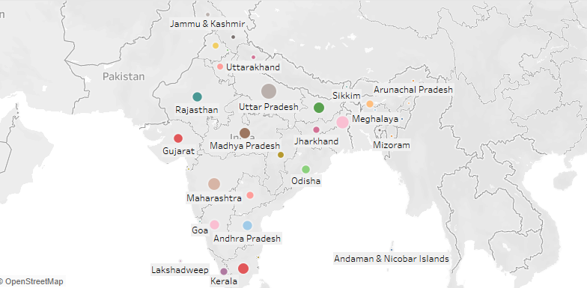
Which state has more votes?
Observation : Uttar Pradesh has more votes.

Slide 9
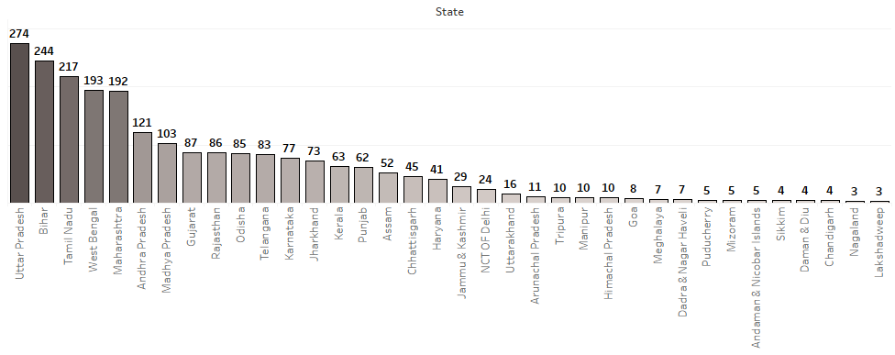
What is the distribution of constituencies over all states?
Observation : Uttar Pradesh , Maharashtra & West Bengal states has more number of constituencies in India

Slide 10
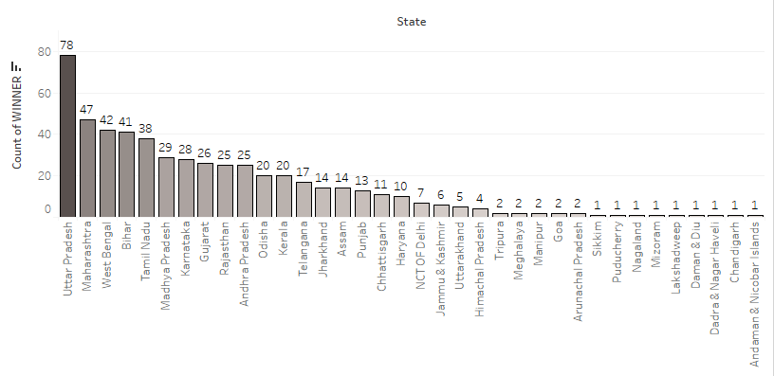
How many seats did the BJP secure in each state
Observation : As BJP Won Election 78 seats are from Uttar Pradesh and 47 from Maharashtra.

Slide 11
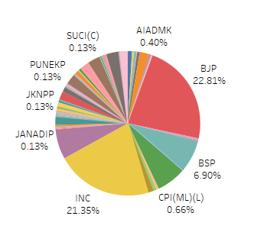
What is the percentage of criminal case of each party?
Observation:
BJP has more Criminal cases

Slide 12
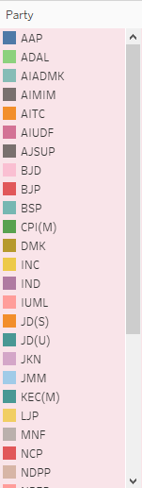
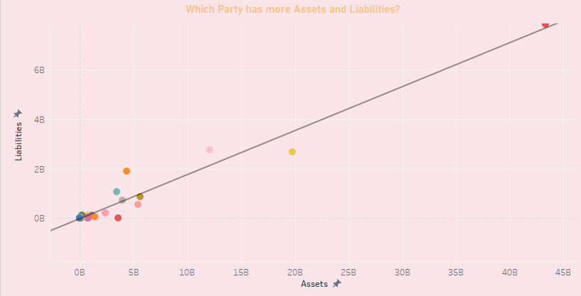
Which Party has more assets and liabilities?
Observation : BJP Party has more assets and liabilities.

Slide 13
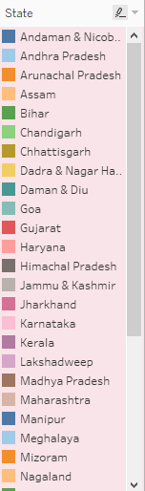
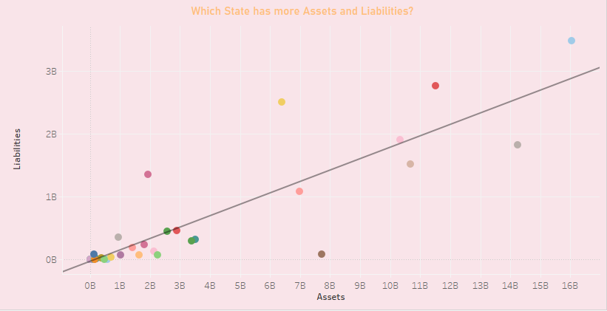
Which state has more assets and liabilities?
Observation : Andhra Pradesh state has more assets and liabilities.

Slide 14
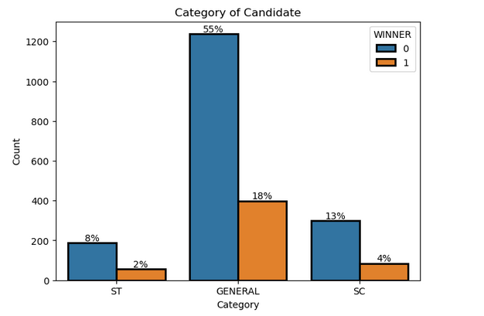
What should be the Category of winning Candidate?
Observation:
Most of the winning Candidates belong to
General Category

Slide 15
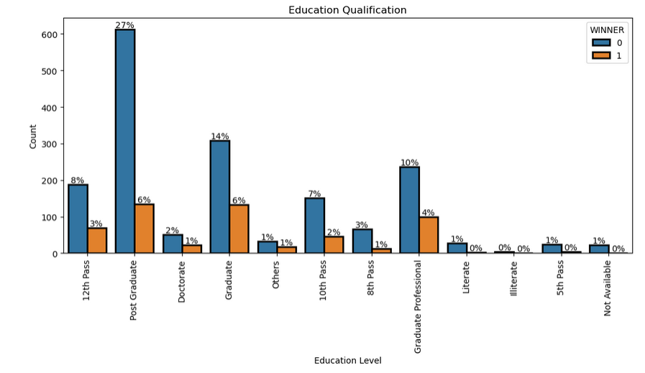
What educational attainment should be expected from a winning candidate??
Observation:
Education of Candidates must be Graduate.

Slide 16
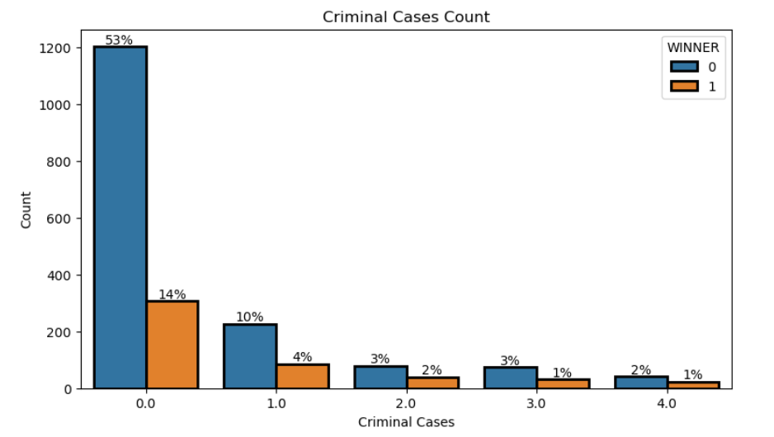
What is the maximum number of criminal cases that a winning election candidate can have without being disqualified?
Observation:
Candidates can have up to 1 Criminal case , but it is suggested not to have any criminal activities.

Slide 17
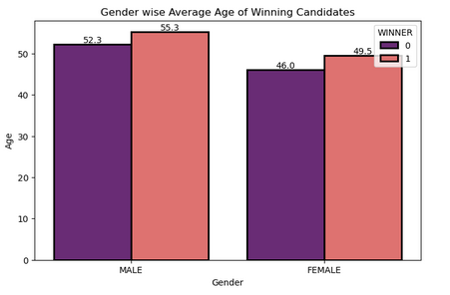
What is the average age of winning election candidates for both male and female contestants?
Observation:
Average age of Winning Female Candidates is 49.5 and Male is 55.3

Slide 18
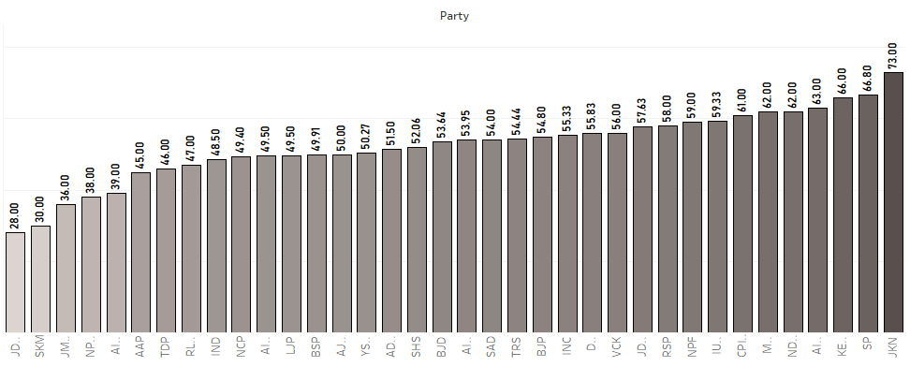
What is the average age of winning candidates of each party in house?
Observation : Old Aged M.P are from JKN & SP Party . Young M.P are from JD(S) & SKM Party

Slide 19
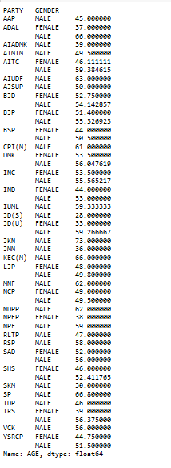
What is the average age of the winning candidates in each party?
Observation:
Average age of BJP Female Candidates is 51.4 and Male is 55.32

Slide 20
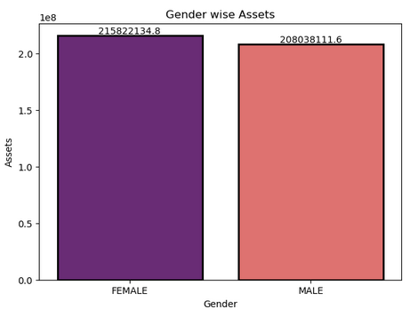
What is the range of assets that a winning MP candidate should have?
Observation:
Female Candidates must have Assets of 215822134.8 & Male Candidates must have 208038111.6

Slide 21
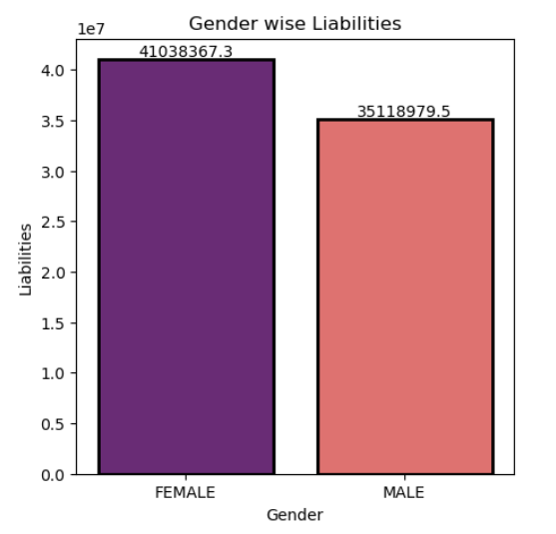
What is the range of liabilities that a winning MP candidate should have?
Observation:
Female Candidates must have liabilities of 4.103837e+07 & Male Candidates must have 3.51189e+07

Slide 22
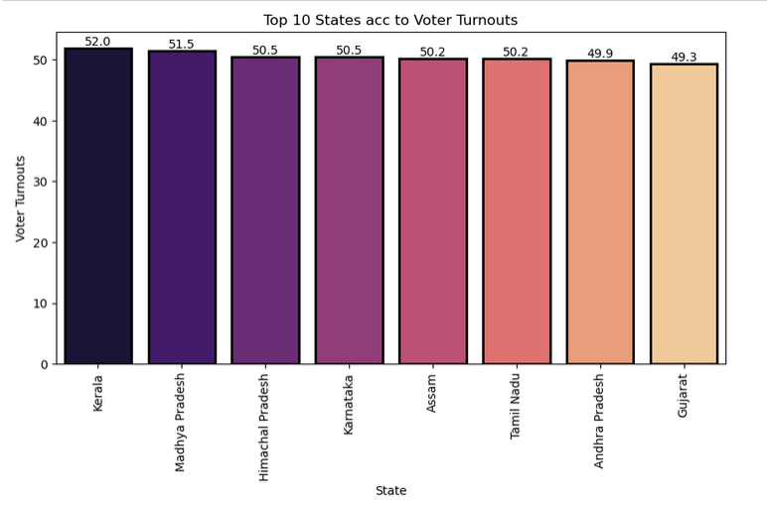
Which are the states with High voter turn outs?
Observation:
Top 10 states with Higher voter turnouts are Kerala, Madhya Pradesh, Himachal Pradesh, Karnataka, Assam ,Tamil Nadu , Andhra Pradesh, Gujrat.

Slide 23
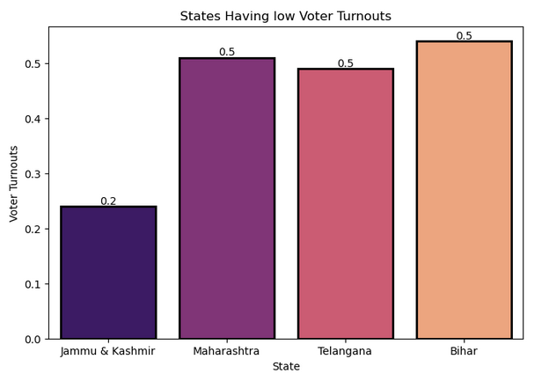
Which are the states with low voter turn outs?
Observation:
The States with lower voter turnouts are Jammu & Kashmir , Maharashtra, Telangana, Bihar

Slide 24
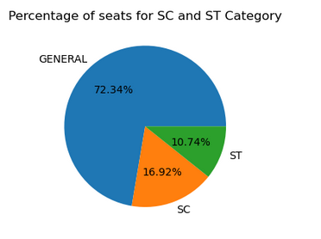
What is the percentage of seats reserved for the SC/ST category?
Observation:
The Percentage of seats reserved for SC is 16.92% and ST is 10.74%.

Slide 25
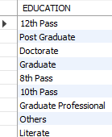
What is Qualification of SC/ST Candidates?
Observation:
Qualification of SC/ST Candidates are 12th Pass , Doctorate ,Post Graduate , Graduate Professional & Others.

Slide 26
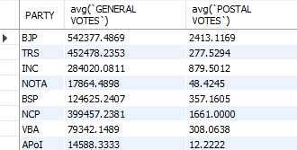
Display Party wise Postal Votes & General Votes
Observation:
Query displays party wise General votes and Postal votes.

Slide 27
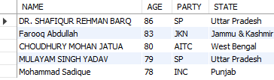
Rank Top 5 oldest winning candidates of the M.P election?
Observation:
Top 5 Old aged winning candidates are DR. SHAFIQUR REHMAN BARQ=86,Farooq Abdullah=83,CHOUDHURY MOHAN JATUA,MULAYAM SINGH YADAV,G. S. BASAVARAJ

Slide 28
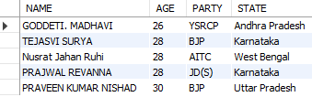
Rank the top 5 young winning candidates of the M P election.?
Observation:
Top 5 Young winning candidates are GODDETI. MADHAVI=26 years , PRAJWAL REVANNA=28,Nusrat Jahan Ruhi = 28,TEJASVI SURYA=28,INDRA HANG SUBBA=30.

Slide 29
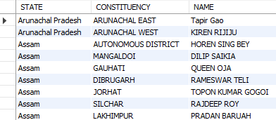
Display State wise ,Constituency wise Winning Candidates name of BJP Party
Observation:
Query displays State wise , Constituency wise Candidates name & Total Votes Polled.

Slide 30
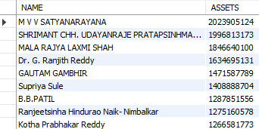
List Name of candidates with assets greater than 1 crore who were victorious in the election.
Observation:
M V V SATYANARAYANA has highest asset followed by SHRIMANT CHH. UDAYANRAJE PRATAPSINHMAHARAJ BHONSLE & MALA RAJYA LAXMI SHAH & so on.

Slide 31
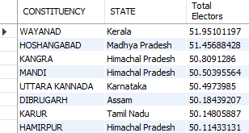
Display Top 10 Constituency having higher number of total electors ?
Observation:
Top 10 Constituency are WAYANAD,HOSHANGABAD,KANGRA,MANDI and so on

Slide 32
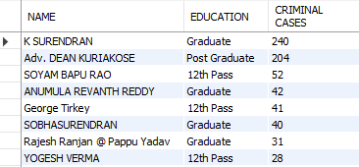
What are the qualifications of the candidate with the highest number of criminal cases?
Observation:
K SURENDRAN has 240 criminal cases his Qualification is Graduate.

Slide 33
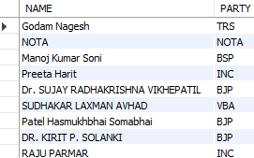
Display Candidates who has no Criminal cases
Observation:
Candidates with out any case are Godam Nagesh , Manoj Kumar Soni , Dr. SUJAY RADHAKRISHNA VIKHEPATIL and so on.

Slide 34
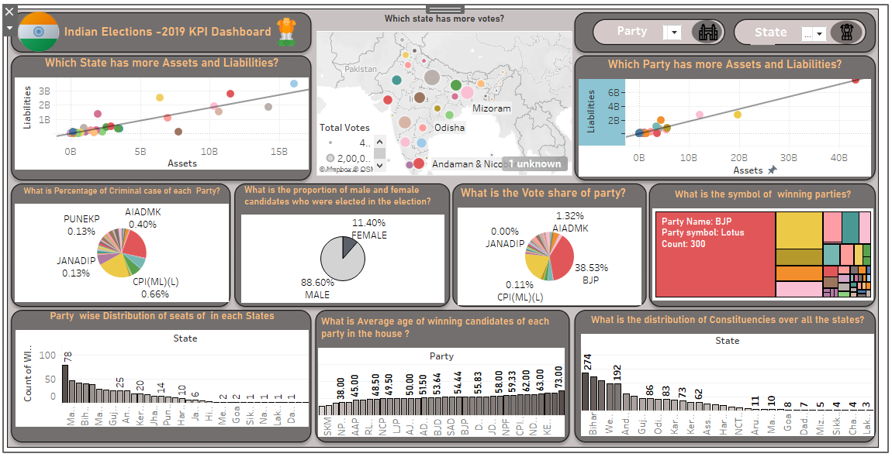
Indian election-2019 kpi dashboard

Slide 35


Observations
In election winner count is 539 and loser count is 1724.
More male candidates contested the election than female candidates.
Many candidates has 0 criminal cases
Many Candidates belong to General Category
Education of Candidate must be Graduate because Only a graduate can understand the complex issues facing our community and make the best decisions for Country.
Winning Candidate can have up to 1 criminal case
16.92% of seats are reserved for SC and 10.74% of seats are reserved for ST

Slide 36
Observations
To Win in M.P Election Female candidates must have asset of 2.158221e+08 & MALE candidates must have 2.080381e+08
To Win in M.P Election Female candidates must have Liabilities of 4.103837e+07 & MALE candidates must have 3.511898e+07
To Win in M.P Election candidates must have average TOTAL ELECTORS count 1.679446e+06
Top 10 states with highest voter turnouts are Kerala , Madhya Pradesh, Himachal Pradesh , Karnataka ,Assam, Tamil Nadu , Andhra Pradesh , Gujarat.
States with lower voter turnouts are Jammu & Kashmir , Maharashtra , Telangana , Bihar

Slide 37
Suggestions
In 2019, the Bhartiya Janata Party (BJP) has claimed the most number of seats all over India. The outreach created by them has really made them claim their position in the Lok Sabha.
Education is regarded as a significant factor for a developing nation like India- where we need educated politicians to lead the nation. Most of the winners are having a graduate + degree.
The general participation of Female politicians is much less than the male politicians. A balanced gander ratio would be good enough.
The average age of politicians is high. It might be an advantage if younger politicians contest and are able to lead the nation.
Candidate should not be involved in criminal activities, They should be more of a role model-rather than someone who is not respected.
The more assets and liabilities a candidate has, the better their chances of winning. Financial resources are essential for winning elections.

Slide 38

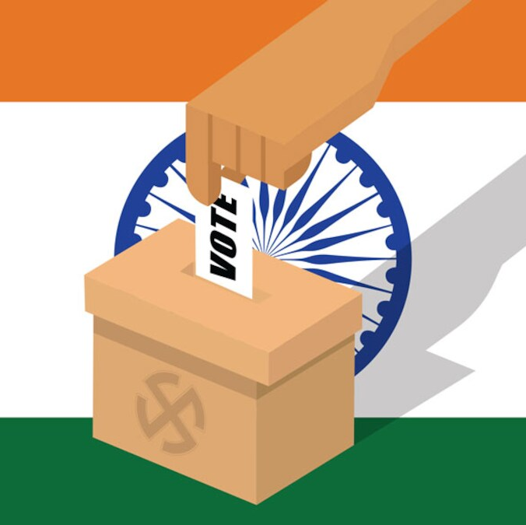
Thank you

